Slide 1

Building the Layout, Style, and CRUD for Your App with HTML and CSS

Slide 2

Overview
Exploring HTML, DOM, CRUD, FORMS
Build out HTML Files for Web App Add Forms To Our HTML Files
Add View to HMTL For Showing List Add CSS To Our HTML Files

Slide 3
Exploring HTML, DOM, CRUD, FORMS

Slide 4
HTML
HTML stands for "HyperText Markup Language."
It’s the basic building block of webpages & defines the structure & content of a website
HTML uses special tags (code enclosed in angled brackets like <tag>) to define different elements on a webpage, such as headings, paragraphs, images, links, & more
Web browsers interpret HTML code & display the webpage according to the instructions provided by the tags

Slide 5
DOM stands for "Document Object Model"
DOM
It’s a programming interface for web documents
Each element is
as a "node" in the DOM tree
They are items in HTML such as headings,
And represent the structure of an HTML or XML
document as a
paragraphs,
tree-like structure
images, etc.
Devs use DOM manipulation techniques to
interact with & modify the content & structure of a webpage dynamically using JavaScript, for dynamic updates & interactivity

Slide 6
CRUD
CRUD stands for Create, Read, Update, and Delete.
Create: Adding new data or records to the system/database
Read: Retrieving or reading existing data from the system/database
Update: Modifying or editing existing data in the system/database
Delete: Removing or deleting data from the system/database
It’s a set of the four primary operations for managing data:

Slide 7



FORMS
Forms in HTML are used to collect user input, such as text, checkboxes, radio buttons, & more
HTML provides various Form Elements: such as input, textarea, select, etc. to create form fields where users can enter information
HTML
Forms
JavaScript can be used to enhance form functionality, validating user input, handling form submissions, and providing interactive experiences
When a user submits a form, the data is sent to a server (backend) for processing, which can then respond with results or store the data in a
database
JavaScri pt Interacti on

Slide 8
Build out HTML Files for Web App

Slide 9
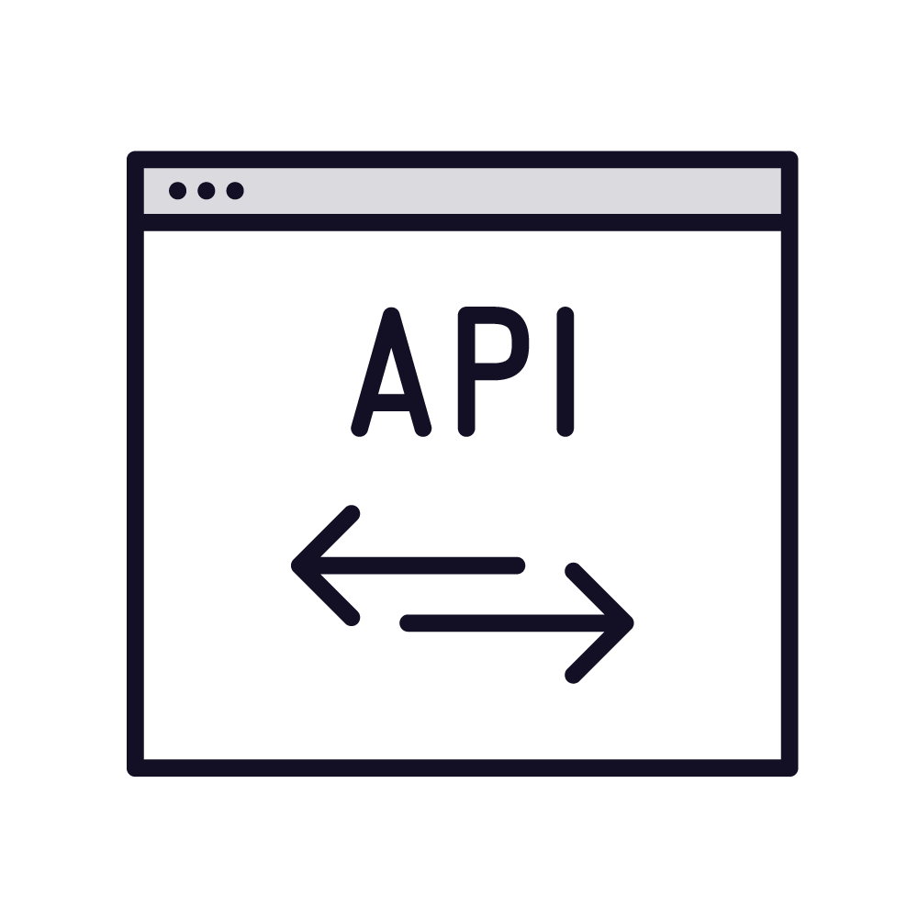

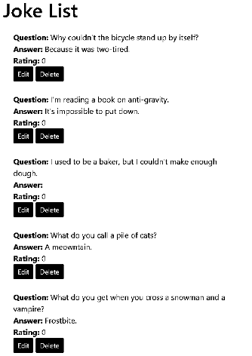


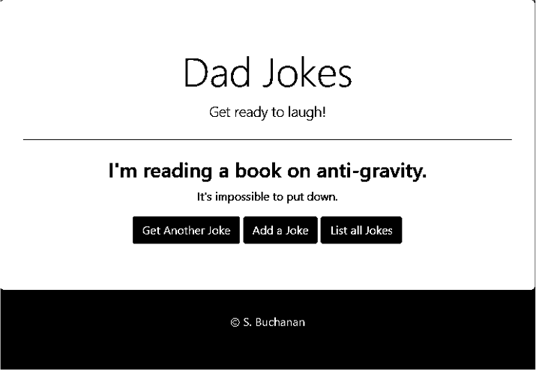

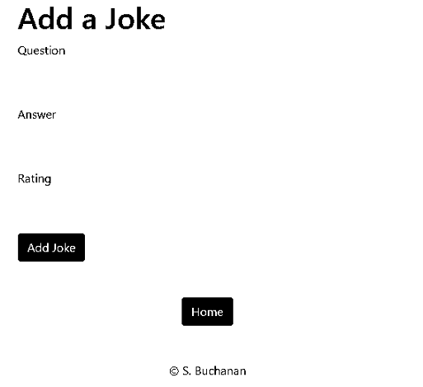











App Components & Architecture
API
(routing)
User Interface
MySQL Database
Back end of web app
Front end of web app
https://github.com/StevenJoseph19/Capgemini-Playwright

Slide 10
Index.html
<!DOCTYPE html>
<html>
<head>
<title>Dad Jokes</title>
</head>
<body>
<h1 class="display-4">Dad Jokes</h1>
<p class="lead">Get ready to laugh!</p>
</body>
Core HTML
<script>
// Function to get a random joke
</script>
<footer>
<Center>
<p><font color="white">&copyAcme Inc.</font></p>
</Center>
</footer>
</body>
</html>

Slide 11
addjoke.html
<!DOCTYPE html>
<html>
<head>
<title>Add Joke</title>
</head>
<body>
<h1>Add a Joke</h1>
<div class="container">
<center><a href="/" class="btn btn-primary">Home</a></center>
</div>
Core HTML
<script src=""></script>
<br>
<br>
<footer>
<Center>
<p>&copy; Acme Inc.</p>
</Center>
</footer>
</body>
</html>

Slide 12
jokeslist.html
<!DOCTYPE html>
<html>
<head>
<title>Joke List</title>
</head>
<body>
<div class="container">
<h1>Joke List</h1>
<ul id="joke-list" class="list-group"></ul>
</div>
Core HTML
<br>
<br>
<div class="container">
<center><a href="/" class="btn btn-primary">Home</a></center>
</div>
<script src=""></script>
<br>
<br>
<footer>
<Center>
<p>&copy; Acme Inc.</p>
</Center>
</footer>
</body>
</html>

Slide 13
Demo
Demo: Build out the initial index.html, addjoke.html, & jokeslist.html files for the app

Slide 14
Add Forms To Our HTML Files

Slide 15
Index.html
<!DOCTYPE html>
<html>
<head>
<title>Dad Jokes</title>
</head>
<body onload="getRandomJoke()"> <!-- Call the function on page load -->
<div class="jumbotron text-center">
<h1 class="display-4">Dad Jokes</h1>
<p class="lead">Get ready to laugh!</p>
<hr class="my-4">
<h3 id="joke-question"></h3>
<p id="joke-answer"></p>
<button class="btn btn-primary" onclick="getRandomJoke()">Get Another Joke</button>
<a href="/features/addjoke/addjoke.html" class="btn btn-success">Add a Joke</a>
<a href="/features/jokelist/jokelist.html" class="btn btn-info">List all Jokes</a>
Forms
</div>
<script>
// Function to get a random joke
</script>
<footer>
<Center>
<p><font color="white">&copy; Acme Inc.</font></p>
</Center>
</footer>
</body>
</html>.

Slide 16
jokeslist.html
<!DOCTYPE html>
<html>
<head>
<title>Joke List</title>
</head>
<body>
<div class="container">
<h1>Joke List</h1>
<ul id="joke-list" class="list-group"></ul>
</div>
Forms
<br>
<br>
<div class="container">
<center><a href="/" class="btn btn-primary">Home</a></center>
</div>
<script src=""></script>
<br>
<br>
<footer>
<Center>
<p>&copy; Acme Inc.</p>
</Center>
</footer>
</body>
</html>

Slide 17
addjoke.html
<!DOCTYPE html>
<html>
<head>
<title>Add Joke</title>
</head>
<body>
<div class="container">
<h1>Add a Joke</h1>
<form id="add-joke-form" action="/jokes" method="POST">
<div class="form-group">
<label for="question">Question</label>
<input type="text" class="form-control" id="question" name="question" required>
</div>
<div class="form-group">
<label for="answer">Answer</label>
<input type="text" class="form-control" id="answer" name="answer" required>
</div>
<div class="form-group">
<label for="rating">Rating</label>
<input type="number" class="form-control" id="rating" name="rating" min="1" max="5" required>
</div>
<button type="submit" class="btn btn-primary">Add Joke</button>
</form>
Forms
</div>
<br>
<br>
<div class="container">
<center><a href="/" class="btn btn-primary">Home</a></center>
</div>
<script src=""></script>
<br>
<br>
<footer>
<Center>
<p>&copy; Acme Inc.</p>
</Center>
</footer>
</body>
</html>

Slide 18
Demo
Demo: add a form to addjoke.html file

Slide 19
Add View to HMTL For Showing List

Slide 20
jokeslist.html
<!DOCTYPE html>
<html>
<head>
<title>Joke List</title>
<link rel="stylesheet" href="https://stackpath.bootstrapcdn.com/bootstrap/4.5.2/css/bootstrap.min.css">
</head>
<body>
<div class="container">
<h1>Joke List</h1>
<ul id="joke-list" class="list-group"></ul>
</div>
View
<br>
<br>
<div class="container">
<center><a href="/" class="btn btn-primary">Home</a></center>
</div>
<script src="jokelist.js"></script>
<br>
<br>
<footer>
<Center>
<p>&copy; Acme Inc.</p>
</Center>
</footer>
</body>
</html>

Slide 21
Jokes List
// Function to display all jokes function displayJokes() {
fetch('/japi/jokes')
.then(response => response.json())
.then(data => {
const jokeList = document.getElementById('joke-list'); jokeList.innerHTML = '';
data.forEach(joke => {
const listItem = document.createElement('li');
listItem.className = 'list-group-item'; listItem.innerHTML = `
<strong>Question:</strong> ${joke.question}<br>
<strong>Answer:</strong> ${joke.answer}<br>
<strong>Rating:</strong> ${joke.rating}<br>
<button class="btn btn-sm btn-primary" onclick="editJoke(${joke.id})">Edit</button>
<button class="btn btn-sm btn-danger" onclick="deleteJoke(${joke.id})">Delete</button>
`; jokeList.appendChild(listItem);
});
})
.catch(error => console.log(error));

Slide 22
Add CSS To Our HTML Files

Slide 23

What is Bootstrap CSS
Bootstrap CSS:
Bootstrap is a popular front-end framework that provides pre- designed CSS styles and components making it easier to build responsive & visually appealing websites
Responsive Design:
Bootstrap's CSS classes are designed to automatically adapt the layout & appearance of a website based on the user's device, such as desktops, tablets, &
Component Library:
Bootstrap offers a wide range of ready-to-use components, like navigation bars, buttons, modals, & more
Customization:
While Bootstrap provides default styles, it also allows developers to customize the framework to match their unique design requirements
https://getbootstrap.com

Slide 24
Index.html
<!DOCTYPE html>
<html>
<head>
<title>Dad Jokes</title>
<link rel="stylesheet" href="https://stackpath.bootstrapcdn.com/bootstrap/4.5.2/css/bootstrap.min.css">
<style>
body {
background-color: purple;
}
.jumbotron {
background-color: gold;
}
</style>
CSS
</head>
<body onload="getRandomJoke()"> <!-- Call the function on page load -->
<div class="jumbotron text-center">
<h1 class="display-4">Dad Jokes</h1>
<p class="lead">Get ready to laugh!</p>
<hr class="my-4">
<h3 id="joke-question"></h3>
<p id="joke-answer"></p>
<button class="btn btn-primary" onclick="getRandomJoke()">Get Another Joke</button>
<a href="/features/addjoke/addjoke.html" class="btn btn-success">Add a Joke</a>
<a href="/features/jokelist/jokelist.html" class="btn btn-info">List all Jokes</a>
</div>
<script>
// Function to get a random joke
</script>
<footer>
<Center>
<p><font color="white">&copy; Acme Inc.</font></p>
</Center>
</footer>
</body>
</html>

Slide 25
addjoke.html
<!DOCTYPE html>
<html>
<head>
<title>Add Joke</title>
<link rel="stylesheet" href="https://stackpath.bootstrapcdn.com/bootstrap/4.5.2/css/bootstrap.min.css">
</head>
<body>
<div class="container">
<h1>Add a Joke</h1>
<form id="add-joke-form" action="/jokes" method="POST">
<div class="form-group">
<label for="question">Question</label>
<input type="text" class="form-control" id="question" name="question" required>
</div>
<div class="form-group">
<label for="answer">Answer</label>
<input type="text" class="form-control" id="answer" name="answer" required>
</div>
<div class="form-group">
<label for="rating">Rating</label>
<input type="number" class="form-control" id="rating" name="rating" min="1" max="5" required>
</div>
<button type="submit" class="btn btn-primary">Add Joke</button>
</form>
</div>
CSS
<br>
<br>
<div class="container">
<center><a href="/" class="btn btn-primary">Home</a></center>
</div>
<script src=""></script>
<br>
<br>
<footer>
<Center>
<p>&copy; Acme Inc.</p>
</Center>
</footer>
</body>
</html>

Slide 26
jokeslist.html
<!DOCTYPE html>
<html>
<head>
<title>Joke List</title>
<link rel="stylesheet"
href="https://stackpath.bootstrapcdn.com/bootstrap/4.5.2/css/bootstrap.min.css">
</head>
<body>
<div class="container">
<h1>Joke List</h1>
<ul id="joke-list" class="list-group"></ul>
</div>
CSS
<br>
<br>
<div class="container">
<center><a href="/" class="btn btn-primary">Home</a></center>
</div>
<script src=""></script>
<br>
<br>
<footer>
<Center>
<p>&copy; Acme Inc.</p>
</Center>
</footer>
</body>
</html>

Slide 27
Demo
Demo: add CSS to the HTML files

Slide 28
In this module we covered:
Reviewed our web apps components & architecture
Looked at HTML, DOM, CRUD, FORMS for review
Built out the HTML code for our Web App
Added forms to the HTML code of our web app
Explored how we will use JavaScript in our HTML to show a list of data
Finished up by addeding CSS to our HTML
Summary
Why this is important:?
We focused on the HTML and CSS of our web app along with the components we will build, along with its architecture. This is a foundational need for the layout, style, and CRUD operations before adding JavaScript to our web app.

